Slide 1
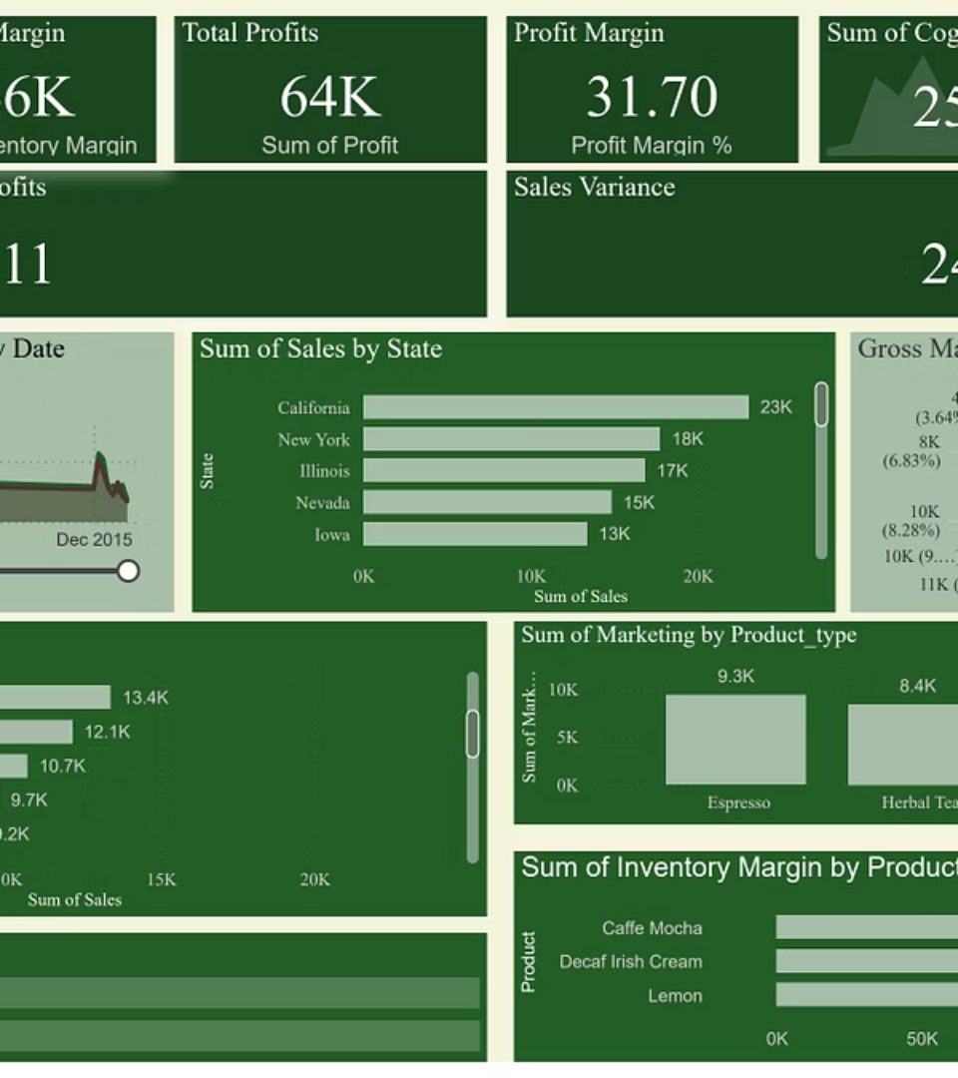

Project Dashboard Overview
Explore key business insights and performance trends.
by Vedant Padhy

Slide 2

Business Objectives
Reveal Insights
Drive Decisions
Uncover hidden patterns and trends in data.
Support strategic choices with clear metrics.
Improve Performance
Identify areas to boost sales and profits.

Slide 3


KPIs & Key Findings
Sales Growth
Profit Margins
Consistent increase in revenue over recent months.
Improved margins due to cost optimisation.
Customer Engagement
Higher interaction rates with marketing campaigns.

Slide 4
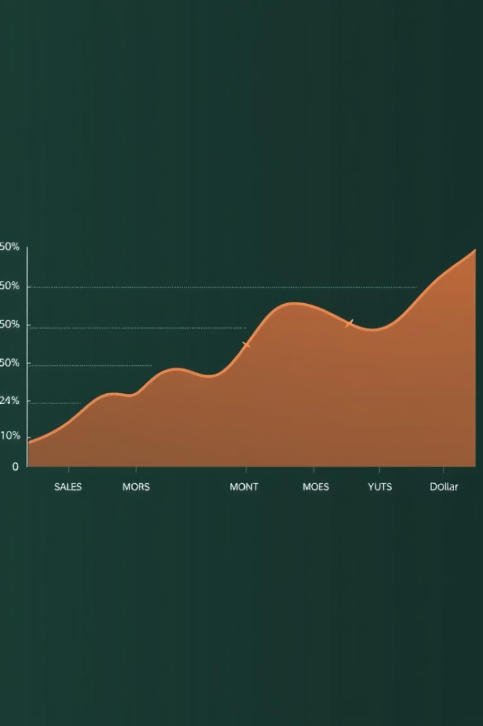
Sales & Profit Trends
1
Q1
Steady sales growth with moderate profits.
2
Q2
Profit margins improved despite sales plateau.
3
Q3
Strong sales surge boosted overall profits.

Slide 5
Regional & Product Performance
Top Regions
Best Products
Western USA leads in sales volume
Columbian drives majority of revenue
North USS shows highest profit margins
Chamomile gains traction in new markets

Slide 6




Recommendations
Focus on High-Performing Regions
Allocate more resources to North and West regions.
Expand Product By Reach
Invest in marketing to grow new market share.
Enhance Customer Engagement
Leverage data to personalise campaigns.

Slide 7

Next Steps
Implement Recommendations
Start with targeted regional investments.
Monitor KPIs
Track sales and profit changes monthly.
Review & Adjust
Refine strategy based on performance data.

Slide 8

Summary & Closing
Dashboard Reveals Key Insights
Sales & Profit Trends Positive
Supports data-driven business decisions.
Growth driven by strong regions and products.
Action Plan Ready
Focus on execution and continuous monitoring.

